Slide 1
Last Update- March ,2021
Welcome at Network Accessories Class
Engr. Md. Abdur Rashid
Director (A & F)
NAPD
www.rashid.info.bd

Slide 2
Outline
NIC
RJ45 Connector
Modem
Hub
Switch
Router
Bridge
Repeater
Optical Fiber

Slide 3
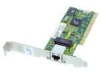
Network Interface Card
The network interface card (NIC) provides the physical connection between the network and the computer workstation.

Slide 4

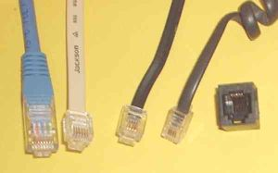
RJ45 CONNECTOR
The RJ 45 connector provides the physical connection between the Switch and the computer workstation (LAN Card).

Slide 5
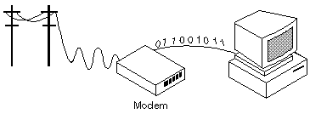
Modem
Modem (from modulator-demodulator) is a device that modulates an analog carrier signal to encode digital information, and also demodulates such a carrier signal to decode the transmitted information.

Slide 6
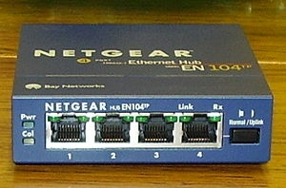
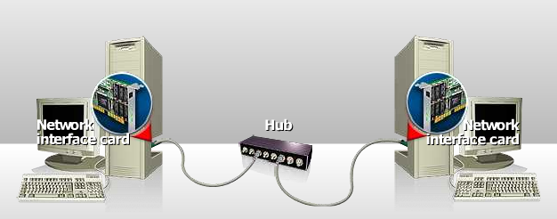
Hub
Defined by
A hub or concentrator is a device for connecting multiple twisted pair or fiber optic Ethernet devices together, making them act as a single segment.
Hubs work at the physical layer (layer 1) of the OSI model. The device is thus a form of multiport repeater.
Hubs are also responsible for forwarding a jam signal to all ports if it detects a collision.

Slide 7
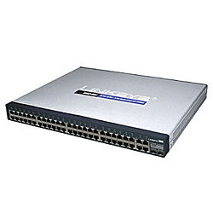
Switch
Defined by
A network switch is a computer networking device that connects network segments.
Linksys 8-port consumer-grade switch.
Linksys 48 port switch.
Low-end network switches appear nearly identical to network hubs,
but a switch contains more "intelligence" (and a slightly higher price tag) than a network hub.
Network switches are capable of inspecting data packets as they are received, determining the source and destination device of that packet, and forwarding it appropriately.
network switch offers generally better performance than a hub.

Slide 8

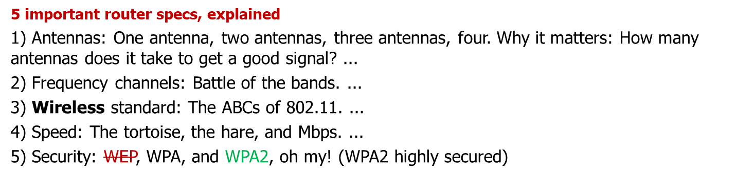
Router
A router is a device that extracts the destination of a packet it receives, selects the best path to that destination
and forwards data packets to the next device along this path.
They connect networks together; a LAN to a WAN for example, to access the Internet. Some units, like the Cisco 1800 (pictured), are available in both wired and wireless models.
Cisco 1800 Router

Slide 9
List of Best Router Brand
Cisco
D-Link
Asus
TP-Link
Netgear

Slide 10
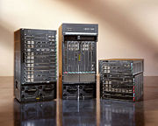
Router
An enterprise router
Cisco 7600 Enterprise Routers

Slide 11
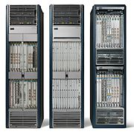
Router
The largest routers (for example the Cisco CRS-1 or Juniper T1600) interconnect ISPs, are used inside ISPs,
or may be used in very large enterprise networks
CISCO CRS-1 ROUTER SYSTEM

Slide 12
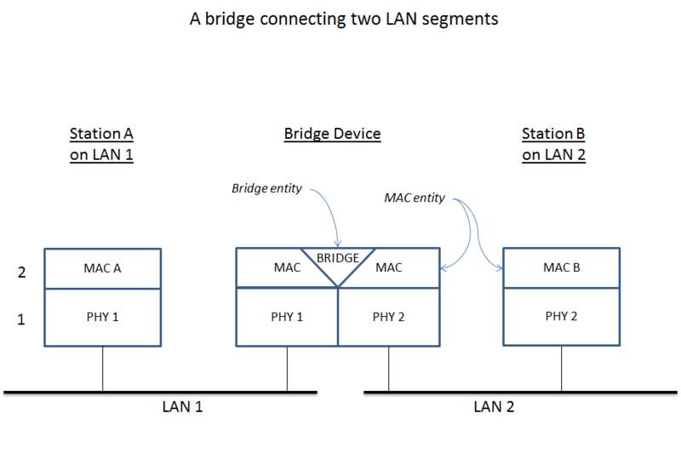
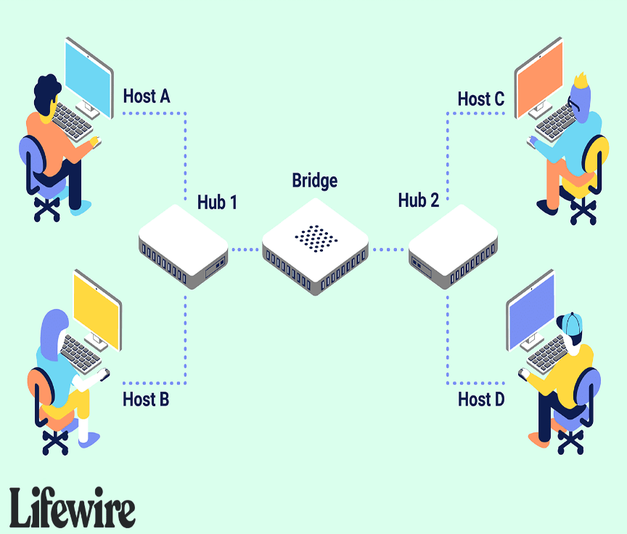
Bridges
The bridge examines the destination address in a frame and either forwards this frame onto the next LAN or does not.
The bridge examines the source address in a frame and places this address in a routing table, to be used for future routing decisions.
Contain table of MAC Addresses.

Slide 13
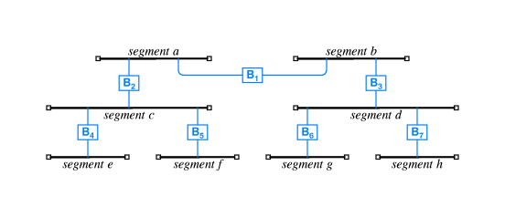
Cycle of bridges
Bridged network can span many segments
Broadcasts are sent to all segments

Slide 14
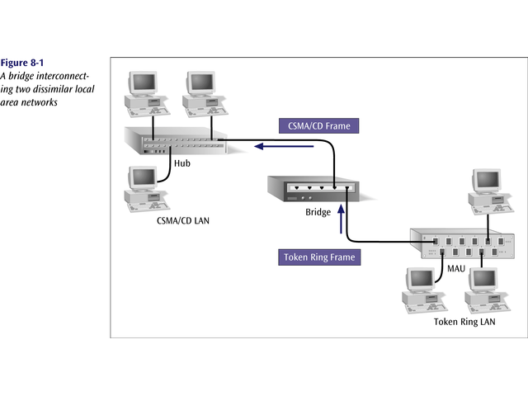
A bridge interconnecting two dissimilar LANs

Slide 15
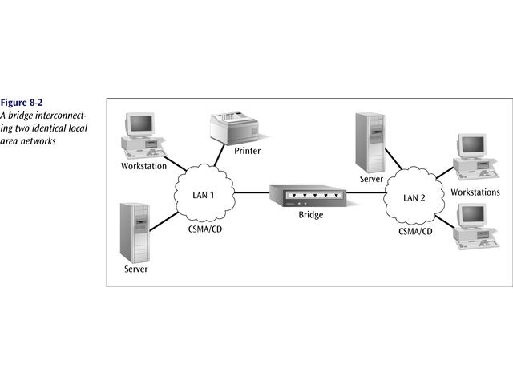
Bridge interconnecting two identical LANs

Slide 16
Bridges vs Routers
Bridge: A bridge is a device that connects two segments of the same network. The two networks being connected can be alike or dissimilar. Unlike routers, bridges are protocol-independent. They simply forward packets without analyzing and re-routing messages.
Router: A router is a device that connects two distinct networks. Routers are similar to bridges, but provide additional functionality, such as the ability to filter messages and forward them to different places based on various criteria. The Internet uses routers extensively to forward packets from one host to another.
Based on these definitions we can see that key difference between a bridge and router is that a bridge does not look at protocols and a router does. A bridge does not look at traffic for the purpose of allowing or disallowing it, and it does not decide what to do with certain types of traffic; it simply moves data from one network to another. Whereas a router examines protocols and decides what to do with each packet based on defined criteria.

Slide 17
Repeaters
Length of cable used influence the quality of communication
Attenuation
Repeaters repeat signals
  Clean and boost digital transmission
  Analog networks use amplifiers to boost signal
Repeaters only work with the physical signal
  Cannot reformat, resize, or manipulate the data
Physical layer (layer 1) device

Slide 18
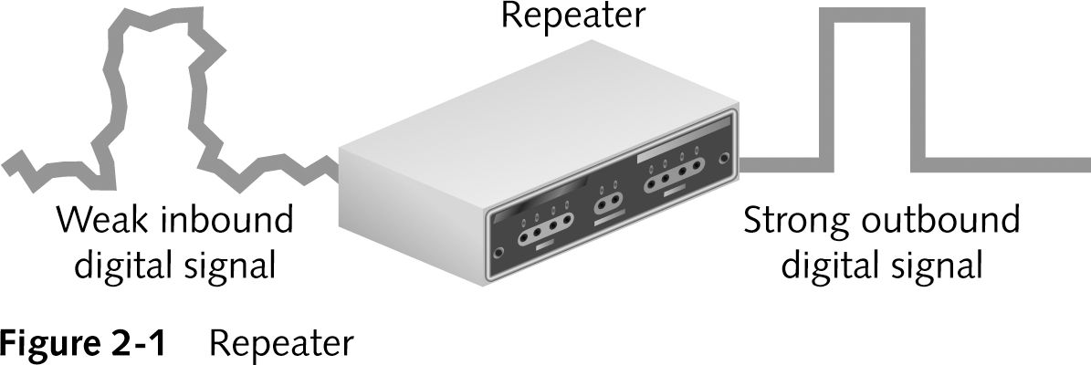
Repeaters (continued)

Slide 19
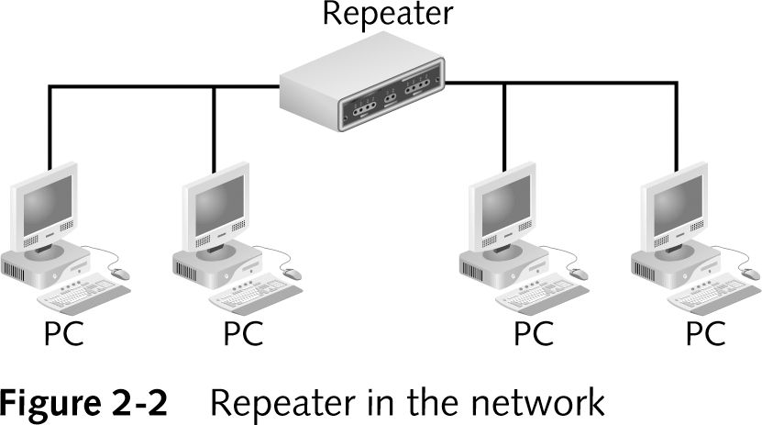
Repeaters (continued)

Slide 20
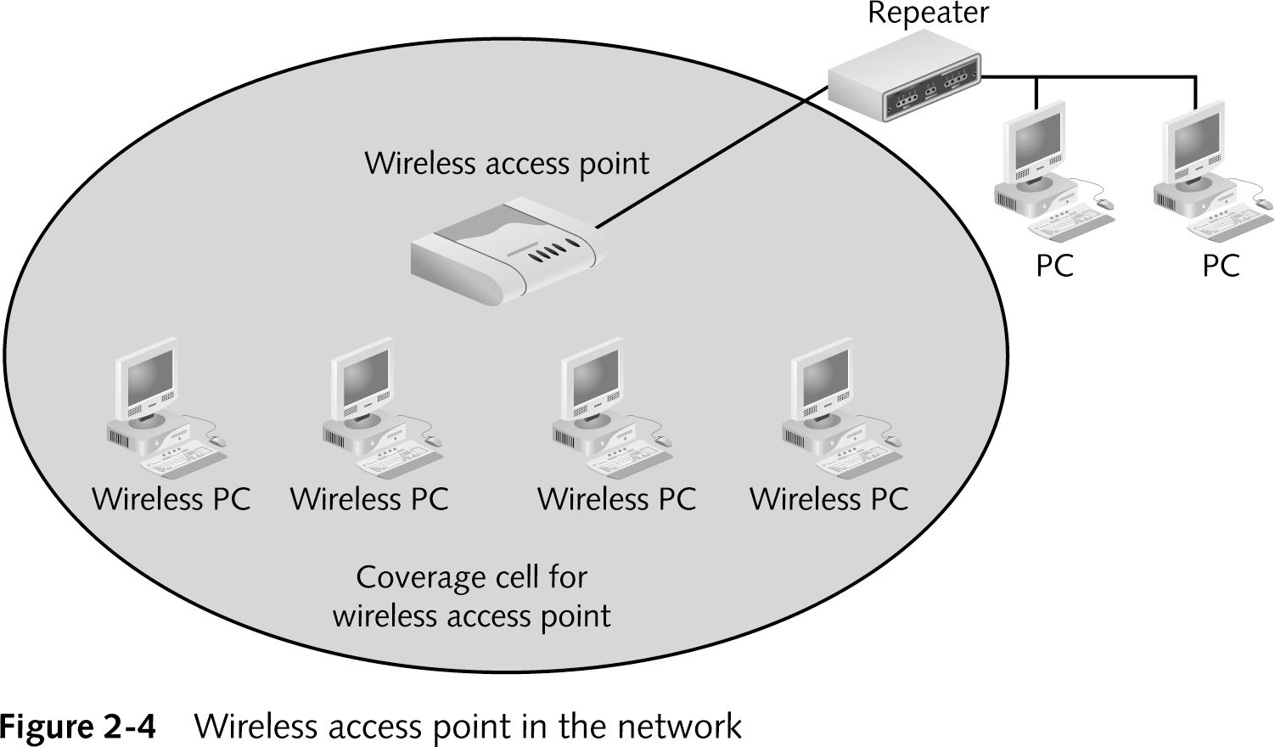
Wireless Access Points (continued)

Slide 21
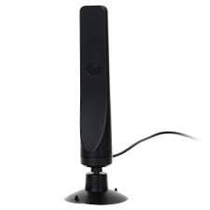
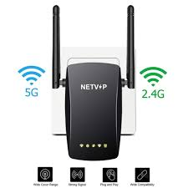
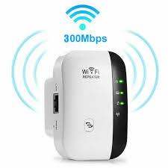
Following are helpful:
Wireless Signal Booster
Wireless amplifier
Wireless signal extender
Wi-Fi Repeater
Wi-Fi Range Extender
NAPD Auditorium is using it and getting strong wireless service

Slide 22
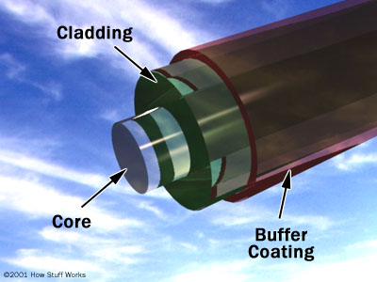
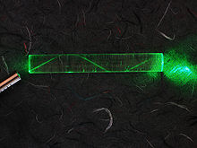
Optical fiber
The light forms an electromagnetic carrier wave that is modulated to carry information.
First developed in the 1970s, fiber-optic communication systems have revolutionized the telecommunications industry and have played a major role in the advent of the Information Age.
much lower attenuation and interference
modern-day optical fibers can carry information at around 14 Terabits per second over 160 kilometers of fiber
bandwidth-distance product of 500 MHz×km could carry a 500 MHz signal for 1 km or a 1000 MHz signal for 0.5 km.

Slide 23
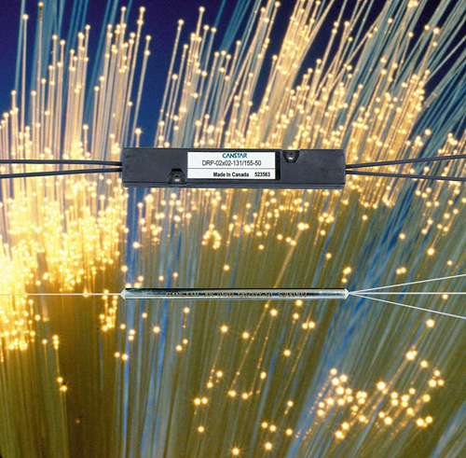
Optical cable line

Slide 24
Optical Fiber - Benefits
Benefits
  Greater capacity
    Available bandwidth: about 50THz
    Data rates of hundreds of Gbps
  Smaller size & weight
  Lower attenuation
  Electromagnetic isolation
  Greater repeater (or amplifier) spacing
    10s of km at least
Applications
  Long-haul trunks
    thousands of km
  Metropolitan trunks
    tens of km
  Rural exchange trunks
    hundreds of km
  Subscriber loops
    To replace twisted pair and coaxial cable
  LANs: very high data rate, 100Mbps to 10Gbps

Slide 25
Advantages of Fiber Optics
Less expensive –
Thinner - Optical fibers can be drawn to smaller diameters than copper wire.
Higher carrying capacity - Because optical fibers are thinner than copper wires, more fibers can be bundled into a given-diameter cable than copper wires. This allows more phone lines to go over the same cable or more channels to come through the cable into your cable TV box.
Less signal degradation - The loss of signal in optical fiber is less than in copper wire.
Light signals - Unlike electrical signals in copper wires, light signals from one fiber do not interfere with those of other fibers in the same cable. This means clearer phone conversations or TV reception.
Low power - Because signals in optical fibers degrade less, lower-power transmitters can be used instead of the high-voltage electrical transmitters needed for copper wires. Again, this saves your provider and you money.

Slide 26
Advantages of Fiber Optics
Digital signals - Optical fibers are ideally suited for carrying digital information, which is especially useful in computer networks.
Non-flammable - Because no electricity is passed through optical fibers, there is no fire hazard.
Lightweight - An optical cable weighs less than a comparable copper wire cable. Fiber-optic cables take up less space in the ground.
Flexible - Because fiber optics are so flexible and can transmit and receive light, they are used in many flexible digital cameras for the following purposes:
Medical imaging - in bronchoscopes, endoscopes, laparoscopes
Mechanical imaging - inspecting mechanical welds in pipes and engines (in airplanes, rockets, space shuttles, cars)
Plumbing - to inspect sewer lines

Slide 27
Thank
Thank

